Slide 1

Micro Project Lab Presentation
Department of MCA
Course Code: P23MCP204
Team Name: Team ESCTRIX
Team Member 1: Jaibl
Reg. No.: 123456
Team Member 2: Jaibl
Reg. No.: 123456

Slide 2
Agenda
Introduction & Problem Statement
Objectives & Scope
Literature Review
Methodology & Tools
System Architecture
Implementation Details
Results & Testing
Challenges & Conclusion
References

Slide 3
Introduction
• Context: AI-driven Recruitment and Candidate Evaluation Platform
• Problem: Manual resume screening is time-consuming and subjective.
• Solution: Resume Sortlist and ATS Score Checker

Slide 4
Problem Statement
Recruiters spend too much time screening resumes and conducting initial technical interviews, leading to inefficiencies and bias.
Significance:
• Automates ATS parsing / Enhances coding tests / Evaluates candidates fairly

Slide 5
Objectives
1. Develop an AI-based Resume Processor and ATS Checker.
2. Implement automated Coding tests evaluation.
3. Create an AI-driven Interview Simulator.
4. Provide a comprehensive dashboard for candidate analysis.

Slide 6
Scope & Limitations
In Scope:
• Resume parsing and ATS scoring.
• Interactive coding assessments.
Limitations:
• Dependent on LLM API availability and accuracy.
• May not evaluate soft skills perfectly.

Slide 7
Literature Review
• Traditional ATS - Pros: Fast. Cons: Keyword-based, misses context.
• Manual Interviews - Pros: Accurate. Cons: Time-consuming, prone to bias.
Gap: An integrated platform offering both ATS checking and AI interviews.
Our Solution: Our platform combines ATS evaluation with automated technical interviewing.

Slide 8
Methodology
• Approach: Agile Methodology
• Planning ? Design ? Development ? Testing ? Deployment

Slide 9
Tools & Technologies
• Frontend: HTML, CSS, JavaScript, Bootstrap
• Backend: Python, Flask framework
• Database: SQLite (esctrix.db)
• Other: VS Code, Git, Google Gemini API

Slide 10
System Architecture
Modules:
• Module 1: Resume Upload & ATS Parsing
• Module 2: Resume Upload & ATS Parsing

Slide 11
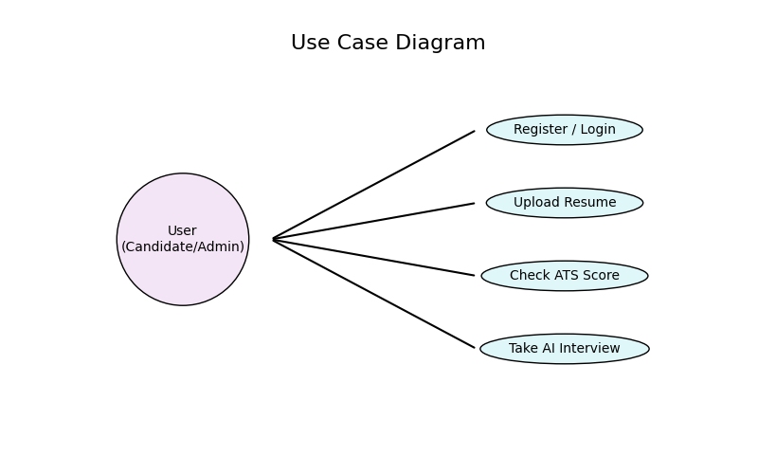
Use Case Diagram

Slide 12
Database Design
• ER Diagram:
• Main Tables: Users, Resumes, InterviewResults
• Relationships: Relational mappings between candidate profiles and their test results

Slide 13
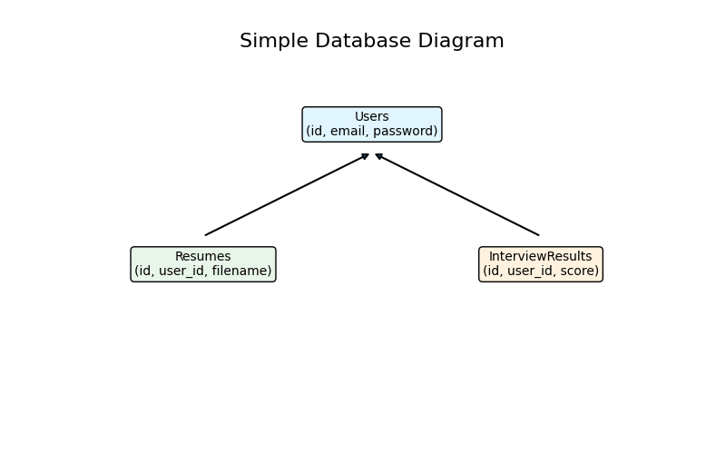
Database ER Diagram

Slide 14
Implementation: Module 1
Function: ATS / Interview Evaluator
Tech: Python, Flask, Gemini API

Slide 15
Module 1 Code: ATS Checker Algorithm
def check_ats_score(file_path, job_description):
text = extract_text(file_path)
# 1. Keyword Match Score Calculation
matched = sorted(list(candidate_skills.intersection(jd_skills)))
keyword_score = (len(matched) / len(jd_skills)) * 25
# 2. Experience Relevance Validation
jd_exp = extract_experience_years(job_description)
res_exp = extract_experience_years(text)
exp_score = 15 if res_exp >= jd_exp else 7
total_score = keyword_score + exp_score + section_score
return {"total_score": total_score, "matched_skills": matched}

Slide 16
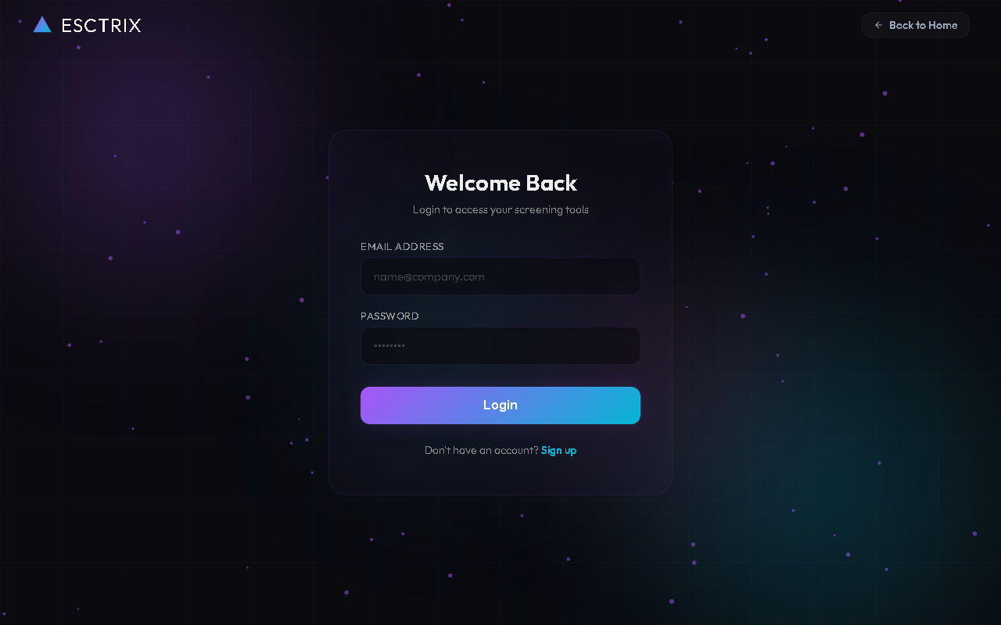
Authentication & Module UI: Login Page

Slide 17
Implementation: Module 2
Function: ATS / Interview Evaluator
Tech: Python, Flask, Gemini API

Slide 18
Module 2 Code: Interview Evaluation API
@interview_bp.route('/api/submit_interview', methods=['POST'])
def submit_interview():
data = request.json
transcribed_text = data.get("transcribed_text")
question = data.get("question")
# AI-Driven Evaluation Using Google Gemini
evaluation = evaluate_answer_with_gemini(transcribed_text, question)
score = evaluation.get("score")
feedback = evaluation.get("feedback")
return jsonify({
"status": "success", "score": score, "feedback": feedback
})

Slide 19
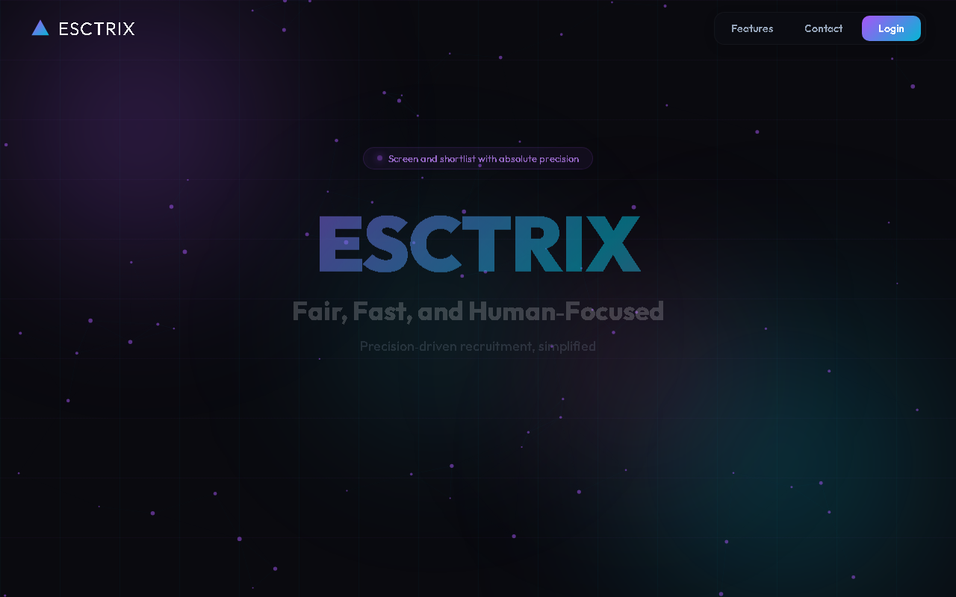
Project Home Dashboard

Slide 20
Results & Outputs
•
• Key Finding: Successfully automated candidate screening, generating detailed ATS and interview scorecards.

Slide 21
Testing & Validation
Test Case 1:
• Expected: Verified working properly
• Actual: Verified working properly ? Pass
Test Case 2:
• Expected: Verified working properly
• Actual: Verified working properly ? Pass

Slide 22
Challenges & Solutions
Challenge 1: Resume Upload & ATS Parsing
? Solution: Fine-tuned Gemini API prompts for structured JSON.
Challenge 2: Resume Upload & ATS Parsing
? Solution: Fine-tuned Gemini API prompts for structured JSON.

Slide 23
Team Contribution
Team Member 1: Jaibl
• Backend Development
• AI Integration
Team Member 2: Jaibl
• Backend Development
• AI Integration

Slide 24
Conclusion
• Achieved: Built an end-to-end automated recruitment platform.
• Key Takeaways: Integrated LLMs effectively into a web application.
• Final Message: Resume Sortlist streamlines hiring, making it fairer and faster.

Slide 25
Future Scope
• Add video interview analysis (facial expression, tone).
• Integrate with LinkedIn and major job boards.
• Scalability: Migrate to cloud infrastructure (AWS/GCP) with scalable databases.
• Predict candidate retention using Machine Learning.

Slide 26
References
References:
• Flask Documentation: flask.palletsprojects.com
• Google Gemini API Docs

Slide 27
Thank You!

